Slide 1





Accelerate .NET to Azure with GitHub Actions
Isaac Levin
Principal Product Marketing Manager
@isaacrlevin

Slide 2
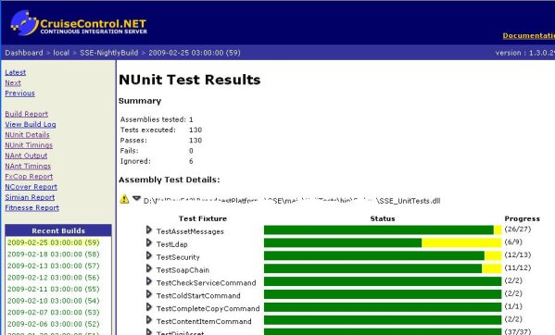




In the Beginning (well not really)
How did we get apps to Production before that CI/CD thing?
Copy / Paste ☺
FTP if you were fancy
Then tools started to show up (but not linked to Repo)
Finally complete CI/CD Tools!!!

Slide 3
What is a GitHub Action?
YAML-Powered Workflows linked to GitHub Repositories
Trigger Workflows with Webhook, Scheduled or Manual Events
GitHub-Hosted Runners pre-installed with tons of tools
Windows, Ubuntu or MacOS provided
Action Run logs available in GitHub Repo Portal
Community Marketplace of Actions and Workflows for nearly every need

Slide 4
It All Starts with setup-dotnet
GitHub Action to configure a dotnet cli environment
Ability to specialize specific version of .NET SDK (including previews)
Configure Environment to use Private Package Sources
Nuget, GitHub Packages, Azure DevOps Artifacts

Slide 5
Where Can I Deploy To?
Azure App Service (obviously)
Azure Functions
Azure Static Web Apps
Azure Kubernetes Service
Really Anywhere Else!!!

Slide 6
When to Deploy to App Service
Traditional Web Applications (Razor Pages, MVC, Web Api, SS Blazor)
Scalable Production Workloads (high performance or even dedicated environments)
When you need a little more control over environment configuration but don’t need the whole OS
Rich feature-set like Slots, VNET Support and Azure Active Directory Integration

Slide 7

Deploy to App Service
Demo

Slide 8
When to Deploy to Azure Functions
Small Stateless Tasks (there are Durable Functions if state is needed)
App Infrastructure doesn’t matter
Event-driven architecture with triggers and bindings (non-Http things)
Extremely Cost Effective*

Slide 9
Deploy to Azure Functions
Demo

Slide 10
When to Deploy to Azure SWA
When you don’t need a server
Building Blazor WebAssembly with or without an Api
Automatic CI/CD Configured at App Creation
Free SSL Certs!!!

Slide 11
Deploy to Azure SWA
Demo

Slide 12
Using GitHub Environments is a good idea
Approvals
Waiting
Branches
Secrets at Environment level

Slide 13
Tools to Extend GitHub Actions
ACT
VS Code Extensions
action-tmate
Call out some ones you use I didn’t mention!

Slide 14
GitHub Actions being Extra
Demo

Slide 15
What about tests?
Playwright to the rescue
UI Testing and Automation Library
Open Source
Works with Chromium-based browsers, Firefox and WebKit
Installs as dotnet global tool once, than added to code via Nuget
Can run in headless mode as well (I wonder where we can use that)
Can use for post-deployment checks inside GitHub Actions
Running tests on a site after publish? YES PLEASE!

Slide 16

your tests with GitHub Actions
Demo

Slide 17
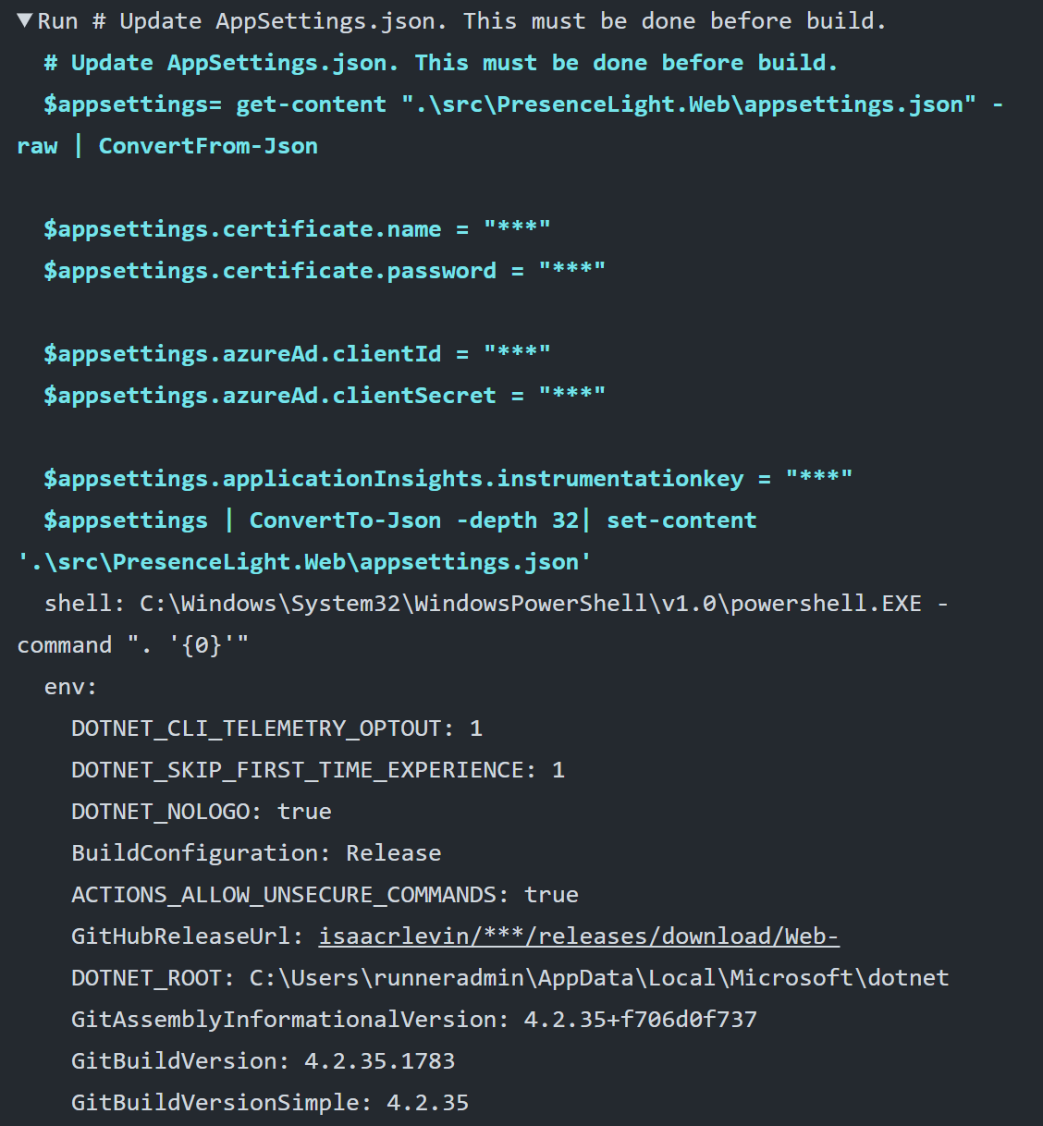





Using CLIs in a GitHub Action
Runners have tons of pre-installed tools

Slide 18
A new way to review PRs
Demo

Slide 19
So To Summarize
Great solution to seamlessly configure CI/CD on your GitHub repos
Building and Deploying .NET Core Applications is painless with GitHub provided Workflows
Plethora of custom workflows including deployment to many Azure Services
Use GitHub Actions WHENEVER you want to deploy ASP.NET Core to Azure!!!

Slide 20

Thanks for joining!
https://isaacl.dev/actions-dotnet-azure

